Slide 1
Session: Problem Solving & Troubleshooting
Watson on Cloud Pak for Data Session ID = J0559, Check-in ID=f3f6
Jennifer Wales
Offering Manager, Data and AI Expert Labs
jennifer_wales@us.ibm.com
Brandon Swink
Analytics and AI Architect, North America
swink@us.ibm.com

Slide 2





You Are Here: how this session fits in the AI Ladder story
Problem Solving and Performance Tuning of Watson on Cloud Pak for Data
Interact with Pre-built AI Services
Watson Application Services
The Ladder to AI
Infuse
Build
Deploy
Catalog
Manage
Analyze
Watson
Studio
Watson Machine Learning
Watson
Knowledge
Catalog
Watson OpenScale
Organize
Collect
Unlock the value of your data and accelerate your journey to AI
AI Open Source Frameworks
Unify on a Multicloud Data Platform
IBM Cloud Pak for Data
A one of a kind, pre-integrated set of data and AI services
delivered within an open and extensive cloud native platform
Cloud-native container platform and operational services
AWS
MS Azure
Google Cloud
2
IBM Cloud
Edge
Private
Hyperconverged
Private Cloud System

Slide 3
Legal Disclaimer
{Remove after Editing: Sections / text in red need to be customized for each presentation and then removed from the final draft.}
© IBM Corporation 2020. All Rights Reserved.
The information contained in this publication is provided for informational purposes only. While efforts were made to verify the completeness and accuracy of the information contained in this publication, it is provided AS IS without warranty of any kind, express or implied. In addition, this information is based on IBM’s current product plans and strategy, which are subject to change by IBM without notice. IBM shall not be responsible for any damages arising out of the use of, or otherwise related to, this publication or any other materials. Nothing contained in this publication is intended to, nor shall have the effect of, creating any warranties or representations from IBM or its suppliers or licensors, or altering the terms and conditions of the applicable license agreement governing the use of IBM software.
References in this presentation to IBM products, programs, or services do not imply that they will be available in all countries in which IBM operates. Product release dates and/or capabilities referenced in this presentation may change at any time at IBM’s sole discretion based on market opportunities or other factors, and are not intended to be a commitment to future product or feature availability in any way. Nothing contained in these materials is intended to, nor shall have the effect of, stating or implying that any activities undertaken by you will result in any specific sales, revenue growth or other results.
If the text contains performance statistics or references to benchmarks, insert the following language; otherwise delete: Performance is based on measurements and projections using standard IBM benchmarks in a controlled environment. The actual throughput or performance that any user will experience will vary depending upon many factors, including considerations such as the amount of multiprogramming in the user's job stream, the I/O configuration, the storage configuration, and the workload processed. Therefore, no assurance can be given that an individual user will achieve results similar to those stated here.
If the text includes any customer examples, please confirm we have prior written approval from such customer and insert the following language; otherwise delete: All customer examples described are presented as illustrations of how those customers have used IBM products and the results they may have achieved. Actual environmental costs and performance characteristics may vary by customer.
Review text for proper trademark attribution of IBM products. At first use, each product name must be the full name and include appropriate trademark symbols. Subsequent references can drop “IBM” but should include the proper branding (e.g., IBM Bluemix or WebSphere Application Server). Please refer to http://www.ibm.com/legal/copytrade.shtml for guidance on which trademarks require the ® or ™ symbol. Do not use abbreviations for IBM product names in your presentation. All product names must be used as adjectives rather than nouns. Please list all of the trademarks that you use in your presentation
If the text/graphics include screenshots, no actual IBM employee names may be used (even your own), if your screenshots include fictitious company names (e.g., Renovations, Zeta Bank, Acme) please update and insert the following; otherwise delete: All references to [insert fictitious company name] refer to a fictitious company and are used for illustration purposes only.

Slide 4
Session Agenda
Introduction to Session​
Expected Outcomes​
Introduce scenarios which return errors in the install or runtime
Teach the attendees how to debug the errors and continue the install.

Slide 5
Debugging with oc / kubectl - the basics
oc get <object>
<object> = node, job, pod, pvc, pv, statefulset, secret, deployment, etc
Cluster nodes status Pods Persistent Volume PV claims oc get nodes oc get pods oc get pv oc get pvc
Flags
-n {namespace} Results for a particular namespace (will default to the namespace you are in)
-all-namespaces Results for all namespaces
-l release={release name} Limits results to a single release
-o wide Output format includes IP & NODE
-o yaml Output format in json format
| grep -Ev ‘Running|Completed’ Shows not running or not complete
Example: oc get pods -n zen –l release=wa14 Get Pods for wa14 release
oc get pods -n zen –l release=wa14 –o wide Get Pods for wa14 release and show what workers they are on
oc get pods --all-namespaces |grep -Ev ‘Running|Completed’ Shows all pods not running or not complete
Shows all pods not running or not complete or not ready
oc get pods --all-namespaces | grep -Ev '1/1|2/2|3/3|4/4' | grep -v 'Completed'
Notes:
Grab handout out of box and follow along

Slide 6
Pod Status
STATUS | DESCRIPTION
Pending | The Pod has been accepted by the Kubernetes system, but one or more of the Container images has not been created. This includes time before being scheduled as well as time spent downloading images over the network, which could take a while. Could also be insufficient resources or volume.
Running | The Pod has been bound to a node, and all of the Containers have been created. At least one Container is still running, or is in the process of starting or restarting.
Succeeded Completed | All Containers in the Pod have terminated in success, and will not be restarted.
Failed | All Containers in the Pod have terminated, and at least one Container has terminated in failure. That is, the Container exited with non-zero status or was terminated by the system.
Unknown | For some reason the state of the Pod could not be obtained, typically due to an error in communicating with the host of the pod.
Notes:
For status pending or init – use describe
For error status – use logs

Slide 7
Pod Status
STATUS | DESCRIPTION
ImagePullBackOff ErrImagePull | Unable to pull image from repository. Find image details using describe pod and compare with ‘docker images’.
CrashLoopBackOff | Container fails as soon as it is started. Could also be insufficient resources or volume, application inside container keeps crashing, some parameters of the pod/container are incorrect.
RunContainerError | Usually result of not finding a dependent resource to set the environment.
ContainerCreating | If Pod remains in this state for an extended period, this indicates some error related to not being able to mount a dependent volume.
MatchNodeSelector | Usually related to scheduling agent error. For example, scheduler is unable to locate a node with the label required to run the Pod on the node. Try “oc get nodes --show-labels”.
Notes:
For status pending or init – use describe
For error status – use logs

Slide 8
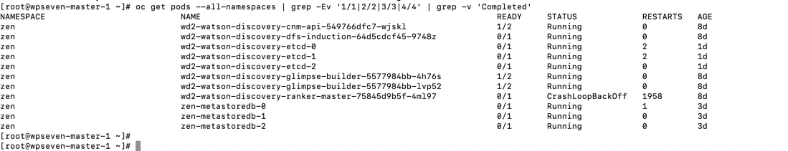
Pods Not Running or Running & Not Ready
oc get pods --all-namespaces | grep -Ev '1/1|2/2|3/3|4/4' | grep -v 'Completed'

Slide 9
Peeling back the onion
oc get <object>
oc describe <object>
<object> = node, job, pod, pv, statefulset, secret…
<pod> = podname
<container> = container name
Cmd = command to run
oc logs <object>
oc logs –f <pod>
-c <container>
oc exec -it <pod> -- cmd
IBM Cloud / © 2019 IBM Corporation

Slide 10
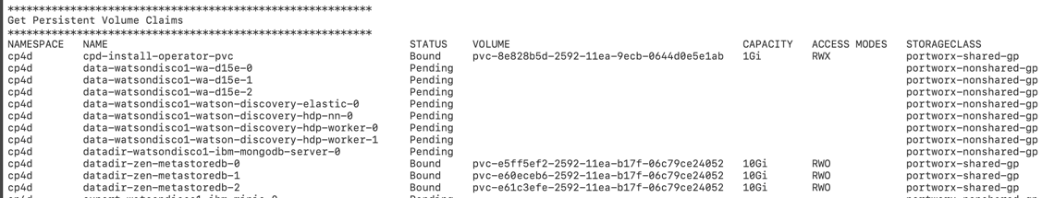
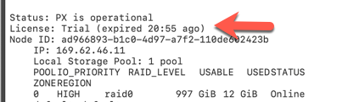
Databases stay in Pending Status (minio, mongo, etcd)
To Debug:
Describe on the pod oc describe pod {podname}
Warning FailedScheduling 1m (x3288 over 1h) default-scheduler pod has unbound PersistentVolumeClaims (repeated 3 times)
Describe on the pvc oc describe pvc {pvc name}
Events:
Type Reason Age From Message
---- ------ ---- ---- -------
Warning ProvisioningFailed 1m (x304 over 1h) persistentvolume-controller Failed to provision volume with StorageClass "portworx-nonshared-gp": rpc error: code = Internal desc = Failed to create volume: Volume (Name: pvc-27a263f5-30bc-11ea-b17f-06c79ce24052) create failed: License has expired
Root Cause:
Portworx trial license expired.
To resolve:
Uninstall Watson Service, uninstall Portworx, and reinstall (assuming CP4d uses NFS)
Notes:
If using OEM license, should not run into this issue.
Running pre-check should catch this as well

Slide 11
Helm
#Check the status of your deployment
helm status --tls {release-name}
#List all of the releases
helm ls --tls
#Delete your deployment
helm delete --purge --tls {release-name}
#Run a test chart
helm test --tls {release-name} --timeout 900
#How to see what values were specified with a deployment
helm get values {release-name} --tls
What is it? https://github.com/helm/helm
Not installed by default – can grab from tiller pod
cd /usr/local/bin
tiller_pod=$(oc get po | grep icpd-till | awk '{print $1}')
oc cp ${tiller_pod}:helm helm
chmod +x helm
./helm init --client-only
Establish the certificate and key for Helm Tiller
export TILLER_NAMESPACE=zen
oc get secret helm-secret -n $TILLER_NAMESPACE -o yaml|grep -A3 '^data:'|tail -3 | awk -F: '{system("echo "$2" |base64 --decode > "$1)}'
export HELM_TLS_CA_CERT=$PWD/ca.cert.pem
export HELM_TLS_CERT=$PWD/helm.cert.pem
export HELM_TLS_KEY=$PWD/helm.key.pem

Slide 12
Debug 101
Primary Problem Areas
Image Load
Helm Install
During Runtime
Many problems can be prevented by
Ensuring cluster is sized properly for deployment
Ensuring prerequisites were met
Follow the instructions – do not go off menu
Importance of understanding the stack when debugging
Bare Metal - VM – OpenShift – CP4D - Watson

Slide 13
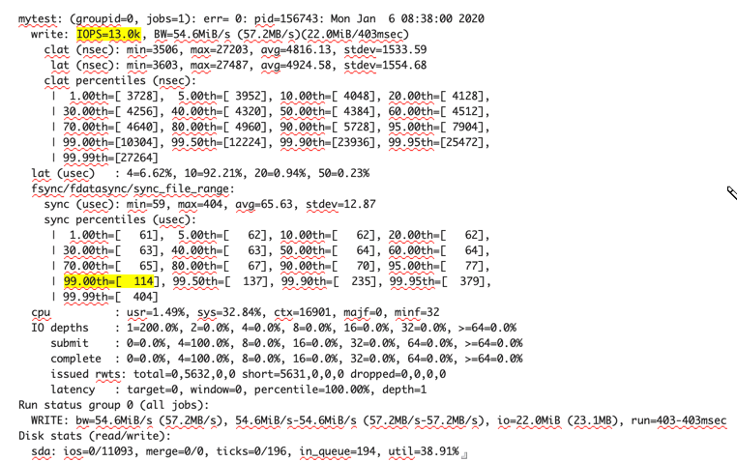
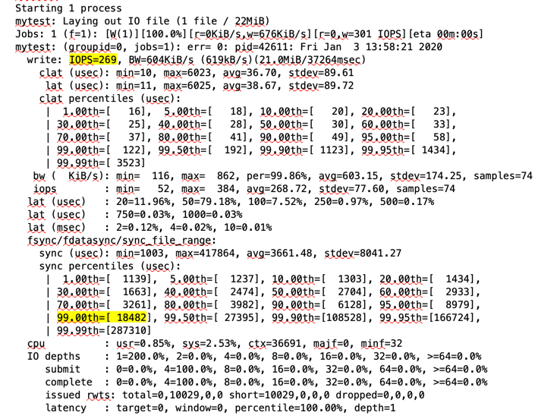
Testing Disk Speed
Slow disk will cause install and runtime problems with Watson
Use procedure below to check your disk throughput
Remote into a worker node -ssh {node}
Install Fio - yum install fio
Run a fio test:
fio --rw=write --ioengine=sync --fdatasync=1 --directory=$PWD --size=22m --bs=2300 --name=mytest
Most important value is the 99th percentile sync time – should be under 10000 (Smaller is better)
Recommended write IOPS for production environments is 500 IOPS (for etcd) (Larger is better)
fyre
Baremetal in softlayer
Notes:
Can work with as few as can run with as few 50 write IOPS, but to be production-worthy the recommendation is 500 IOPS

Slide 14
Testing Disk Speed with dd
Disk latency test
dd if=/dev/zero of=/path-to-installation-directory/testfile bs=512 count=1000 oflag=dsync
The value must be better or comparable to: 512000 bytes (512 KB) copied, 1.7917 s, 286 KB/s
Disk throughput test
dd if=/dev/zero of=/path-to-installation-directory/testfile bs=1G count=1 oflag=dsync
The value must be better or comparable to: 1073741824 bytes (1.1 GB) copied, 5.14444 s, 209 MB/s
https://www.ibm.com/support/knowledgecenter/SSQNUZ_2.5.0/cpd/plan/rhos-reqs.html

Slide 15
#1 Problem loading the Images
First step in installing Watson Services is uploading images to the docker repository.
Possible scenarios
Image load fails with unauthorized: authentication required
Image load fails with Unknown Blog
Image load fails with out of disk error
Debug Steps:
Make sure you have enough space `df –h`
100G should be enough for extracting image
200G recommended for /docker/var/lib
Make sure you are logged into docker `docker images`
Check for Published route ` oc get routes -n default`
Next Steps:
Resolve underlying space issue
Login to docker and use published route
Re-start image load (deploy.sh or loadImagesOpenShift.sh) script
Notes:
Unknown blob due to slower storage, masters cannot keep repo in sync
should retry up to 5x
more prone if to using internal service - try using published route
push using external route

Slide 16
#2 Problem during Helm Install
Second step in installing Watson Services is deploying the chart (Helm install)
Assistant install straightforward and generally successful unless proper steps are not followed
Discovery 2.1 install may fail even if proper steps followed.
Discovery Hotfix 2.1.1 is the recommended starting point when debugging: https://cloud.ibm.com/docs/services/discovery-data?topic=discovery-data-release-notes#24jan2020
Debug Steps:
Use the Watch command to automatically refresh and see what is going on during install
watch oc get job,pod -n zen -l release={releasename}
Look for pod failures
Stateful sets should go running first – Minio, Mongo, Postgres (keeper), etcd
Look for Jobs taking too long (generally a minute or so after image is pulled)
Notes:
Second step in installing Watson Services is deploying the chart (Helm install)
WA generally will succeed as long as you met prereqs, used the right inputs and are properly sized.
WDS can fail even if all of the prereqs are met and proper steps followed
Use watch command to see how things spin up or if a pod is in trouble or the install blocked.
Use oc commands to dig into root cause

Slide 17
Overview of Assistant Install Problems
Master or Store Pods not starting
Install successful but tooling not working
Notes:
Second step in installing Watson Services is deploying the chart (Helm install)
WA generally will succeed as long as you met prereqs, used the right inputs and are properly sized.
WDS can fail even if all of the prereqs are met and proper steps followed
Use watch command to see how things spin up or if a pod is in trouble or the install blocked.
Use oc commands to dig into root cause

Slide 18
Assistant – Master or Store pods not starting
Most of your WA deployment looks good, but a few will not start, including master and store
Debug Steps:
Run a describe on the problem pod(s)
`oc describe {pod-name]`
If problem related to a secret name, you likely did not specify the correct docker secret when performing helm install.
‘oc get secrets | grep default-dockercfg` #to find docker secret
Next Steps:
Remove deployment
Cleanup remaining artifacts
Re-run Helm Install / increment release name
Loading Images, Labeling Namespace, etc only required once per cluster

Slide 19
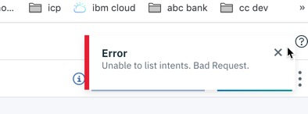
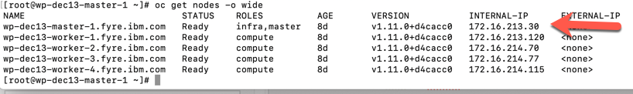
Assistant – Install successful, but tooling not working
WA Installation deployed without error, but cannot create a skill or import into tooling
Debug Steps:
Try incognito mode of your browser
If still failing, could be bad IP provided during install.
To check
`helm get values {release-name] –tls`
To see master IP: ‘oc get nodes –o wide’
Next Steps:
Remove deployment
Cleanup remaining artifacts
Make changes to values-override.yaml
Re-run Helm Install
Loading Images, Labeling Namespace, etc only required once per cluster

Slide 20
Overview of Discovery Install Problems
Stateful Sets not starting (Postgres, etcd, elastic)
in Pending State
Running but not ready
Deploy successful, but not all pods starting
Ranker
Dfs induction / modelmesh
Installing the optional language pack
Notes:
Second step in installing Watson Services is deploying the chart (Helm install)
WA generally will succeed as long as you met prereqs, used the right inputs and are properly sized.
WDS can fail even if all of the prereqs are met and proper steps followed
Use watch command to see how things spin up or if a pod is in trouble or the install blocked.
Use oc commands to dig into root cause

Slide 21
Discovery – all etcd pods do not all start
Etcd needs to reach a quorum before the job times out. Slowness within the cluster can cause this condition.
Next Steps:
watch oc get job,pod -n zen -l release={releasename}
If one of the 3 pods is in CrashLoopBackOff, manually delete it. This may be more effective than the recreation process. If you can get pod running in time, install will continue
If install errors
Remove deployment
Cleanup remaining artifacts
Re-run deploy.sh
Notes:
When re-running install multiple times, use a new name to prevent problems from previous deploy and make debugging easier

Slide 22
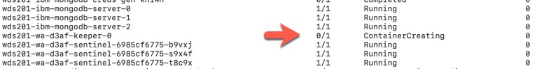
Discovery – postgres keeper pod won’t start
In this example, The watson-discovery-postgresql-creds-gen job failed, so the watson-discovery-postgresql-auth-secret secret was not created, so none of the pods from the wds-wa-d3af-keeper stateful set (a.k.a. postgres) could start, and every component of Discovery that then relies on Postgres then failed to start, or started unhealthy
Debug: Next Steps:
oc describe pod {podname} -Remove deployment
-Cleanup remaining artifacts
-Re-run Install

Slide 23
Discovery – elastic pod not starting / or not ready (0/1 Running)
Elastic plugin job will fail unless elastic pod starts. This is the last job to run, so if you can fix it before it times out, the install will succeed. Many problems in elastic are caused by missing prereqs, but even proper installs will fail here.
Resolution - rerun the {release-name}-watson-discovery-elastic-init-plugin-job
oc get job {release-name}-watson-discovery-elastic-init-plugin-job -o yaml >job.yaml
Modify job.yaml as follows:
Delete the status: block entirely
Delete all of this:
selector:
matchLabels:
controller-uid: b5a0c003-1622-11ea-9e97-00163e01c9ab`
Delete the `controller-uid` key and value
Save the file
Delete & re-run the job:
`oc delete job {release-name}-watson-discovery-elastic-init-plugin-job && oc apply -f ./job.yaml`

Slide 24
Discovery – elastic pod will not start
Elastic pod not starting even if manually deleted
Debug Steps:
Verify prereqs: vmm setting, selinux and CRI-O pid limits are set; if missed, set and restart cluster
https://apps.na.collabserv.com/wikis/home?lang=en-us#!/wiki/Wd855b33ea663_4b57_a7c7_f5e8e37c2716/page/Watson%20Install%20Prereqs%20(Q4%202019%20Release)
Verify Discovery pods are using the ibm-discovery-prod-scc (and not nonroot which is a bug)
oc get pods | grep elastic-0
oc get pod {elastic pod name} -o yaml | grep scc
you are looking for: `openshift.io/scc: ibm-discovery-prod-scc`
Next Steps:
Set required prereq configuration settings (if missed)
Remove deployment
Cleanup remaining artifacts
Re-run deploy.sh

Slide 25
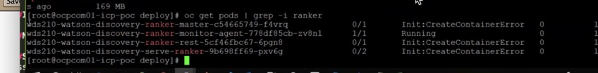
Discovery – deploy successful, but pods not starting
All jobs succeeded, but some pods are not starting, like Ranker
Debug Steps:
Try deleting a problem pod(s) to see if it will recreate
`oc delete {pod-name]`
Run a describe on the problem pod(s)
`oc describe {pod-name]`
Error: Manifest does not match provided manifest digest sha256:aab8d8e851110e783a870ccd55049 bd01cb2340a0a0559a9dfd5fc9002ac898d
Problem was due to an issue uploading the images.
Next Steps:
Remove the problem images
Remove deployment
Cleanup remaining artifacts
Re-run Install
Notes:
Knowing the order helps here.

Slide 26
Discovery – deploy successful, but dfs pods not starting
dfs-induction and dfs-modelmesh pods not starting.
{release-name}-watson-discovery-dfs-secret-gen-job failed and without needed secret, pods will never start.
Resolution - rerun the {release-name}-watson-discovery-dfs-secret-gen-job
oc get job {release-name}-watson-discovery-dfs-secret-gen-job -o yaml >job.yaml
Modify job.yaml as follows:
Delete the status: block entirely and the following under metadata
+ creationTimestamp
+ selfLink
+ uid
Delete all of this:
selector:
matchLabels:
controller-uid: b5a0c003-1622-11ea-9e97-00163e01c9ab`
Delete the `controller-uid` key and value
Save the file
Delete & re-run the elastic-init job:
`oc delete job {release-name}-watson-discovery-dfs-secret-gen-job && oc apply -f ./job.yaml`

Slide 27
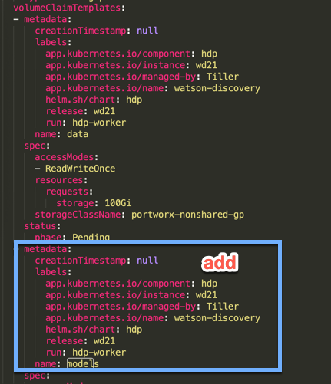
Discovery – Debugging the Optional Language Pack
If the hdp-worker pods continue to terminate and never start, the init-models init container may be failing due lack of EmptyDir space within the pod.
Resolution - Recreate the statefulset for the hdp-workers with a volume to use for model creation
oc get statefulset {release-name}-watson-discovery-hdp-worker -o yaml >ss.yaml
Modify ss.yaml as follows:
Delete the volumes:
- emptyDir: {}
name: models
and the readOnly:true from the mountPath for the hdp-worker volumeMount
Delete the status block and status: phase: Pending
Copy the volumeClaimTemplates metadata section and paste below that section then modify the pasted section changing `name: data` to `name: models`
Save the file
Delete & recreate the statefulset
oc get statefulset {release-name}-watson-discovery-hdp-worker -o yaml >ss.yaml`
Notes:
After installation, the hdp-worker pods (0 and 1) will be stopped and restarted with the updated nlp-models; hdp-worker-1 first, and once successful, then hdp-worker-0. Due to the size of the new image (nlp-models-en is 1.01 GB/ nlp-models is 19.7 GB), this process can take up to 40 mins per service.

Slide 28
#3 Problem with Runtime
Runtime problems can be challenging if pods are all running
Useful if you have a baseline collector log and know that at one point everything did work
Debug Steps:
Verify all pods are still running – expand to all namespaces
oc get pods --all-namespaces |grep -Ev ‘Running|Completed’
oc log {object} job, pod, pv
Run test chart
Helm test {release-name} –tls
Use Collector script to gather logs into single tar file for easy viewing / searching
Search on / grep for ‘exception’ or ‘err’
Next Steps:
Delete problem pods (if one is found)
Scale deployment down / up to ‘reboot’ service (do not use with localstorage) https://apps.na.collabserv.com/wikis/home?lang=en-us#!/wiki/Wd855b33ea663_4b57_a7c7_f5e8e37c2716/page/How%20to%20scale%20WA%201.2%20from%20Dev%20to%20HA
Collect logs & reach out to development

Slide 29
Discovery – Cannot create a collection or ingest documents
Next Steps:
Make sure CRI-O Pid limit is set to a minimum of 4096 as needed for Discovery
if not, add pids_limit = 8192 under the [crio.runtime] section in /etc/crio/crio.conf
Restart nodes & retest
If still having trouble, will need to gather wexlogs (can use lines below or openshiftCollector)
PODNAME=$(oc get po | grep discovery-gateway-0| awk '{ printf $1 }')
oc exec $PODNAME -- tar -czvf /wexdata/wexdata-logs.tar.gz /wexdata/logs
oc cp $PODNAME:wexdata/wexdata-logs.tar.gz ./wexdata-logs.tar.gz
Reach out to Dev
Notes:
Saw this problem 2x:
Cluster that was previously working and verified
New install that deployed successfully but was having trouble with (1) etcd pod and or SDU pod
Not sure what to look for in wexlogs

Slide 30
Discovery – Postgres won’t go running
Scenario – working Discovery instance that suddenly stops working and postgres keeper refuses to start.
Resolution – recreate the statefulset for keeper
oc get statefulset {release-name}-watson-discovery-keeper -o yaml >keeper.yaml
Modify keeper.yaml as follows:
Modify the podManagementPolicy to be Parallel
Delete the status: block entirely and the following under metadata
+ creationTimestamp
+ selfLink
+ uid
Delete all of this:
selector:
matchLabels:
controller-uid: b5a0c003-1622-11ea-9e97-00163e01c9ab`
Delete the `controller-uid` key and value
Save the file
Delete & recreate the statefulset
oc get statefulset {release-name}-watson-discovery-keeper -o yaml >keeper.yaml`

Slide 31
openshiftCollector.sh
Bulk capture of configuration settings and logs needed for debugging Watson on CP4D on OpenShift.
./openshiftCollector.sh [--cluster <openshift-cluster>] [--namespace <openshift-project>] [--username <openshift-admin-user>] [--password <openshift-admin-password>] [--skip-auth] [--tls]
Flags: -c, --cluster The OpenShift cluster to connect to (without protocol and port number) -n, --namespace The OpenShift project (i.e. namespace) to run diagnostics against -u, --username The OpenShift username to log in with (defaults to "ocadmin") -p, --password The OpenShift password to log in with (defaults to "ocadmin") -t, --tls Add the --tls flag to all helm commands --skip-auth The namespace, username and password flags aren't required and will be ignored if they are supplied and the script will rely on the user having already authenticated with OpenShift (using oc login) before running the script.
./openshiftCollector.sh -c oscluster.domain.com -u ocadmin -p ocadmin -n zen -t
Must Gather: https://apps.na.collabserv.com/wikis/home?lang=en-us#!/wiki/Wd855b33ea663_4b57_a7c7_f5e8e37c2716/page/Mustgather%20data%20collection
Scripts can be found here: https://ibm.box.com/s/wo344kbjz7gihm3dq27hdlymn32yx2cv
Notes:
Versions avail for icp also

Slide 32
How to reinstall Watson Service
In case of a failed deployment:
Look at logs to determine source of the trouble
Remediate and try install again after clean delete (instance, deployment, artifacts, configmap)
Best Practice – do not reuse release-name for subsequent installation(s)
Steps To Reinstall
Run steps at bottom of cheatsheet to delete deployment
Make Changes to override-yaml (if needed)
In Cheatsheet, File, Replace release name
Login to oc and docker
Change into the charts (WA) or deploy (WD) directory
Run helm install (WA) or deploy.sh (WD) with new release name
Prereq steps, labeling namespace, creating storageclasses, etc only are not needed for a reinstall on the same cluster
Uploading images to registry only needed once unless changing version
Notes:
Change release name on subsequent installs in case residue from previous install remains

Slide 33
How to get Support
Customer Support
Open a ticket and escalate to Slack channels below if needed
https://www.ibm.com/mysupport/s/
Pre-Sales Support
Cloud Pak for Data – Slack #cloudpak4data-support
Watson Assistant - Slack: #wdc-assistant-help
Watson Assistant with Voice Interaction – Slack #watson-wavi
Watson Discovery - Slack: #wd-cp4d-technical
WKS Support - wks forum: https://w3-connections.ibm.com/forums/html/forum?id=5f43a252-c824-4741-9598-3b45067f0701&ps=25
NLU Support – Slack: #nlu-icp
Speech Support – Slack: #speech-icp
Language Translation Support – Slack # wdc-language-translat
****Always include configuration and logs for faster response – use collector scripts ****
https://apps.na.collabserv.com/wikis/home?lang=en-us#!/wiki/Wd855b33ea663_4b57_a7c7_f5e8e37c2716/page/Watson%20%26%20CP4D%20Support

Slide 34
References
DAELL CP4D Practice Wiki: www.ibm.biz/watsoncp4d
CP4D Product Home: https://www.ibm.com/support/producthub/icpdata/docs/content/SSQNUZ_current/cpd/overview/overview.html
Faststart replays on Seismic: https://ibm.seismic.com/Link/Content/DChXM-Dl2TbkO4gQPCGpez_g

Slide 35
Thank you

Slide 36
Please give us your feedback – Access the survey link at the bottom of the
session details in the mobile app.
Jennifer Wales
Offering Manager, Data and AI Expert Labs
jennifer_wales@us.ibm.com
Brandon Swink
Analytics and AI Architect, North America
swink@us.ibm.com

Slide 38
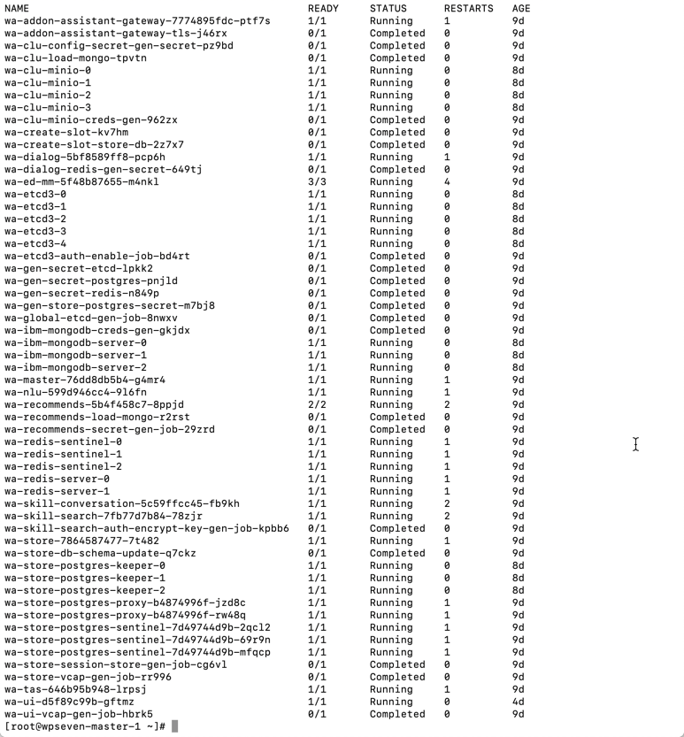
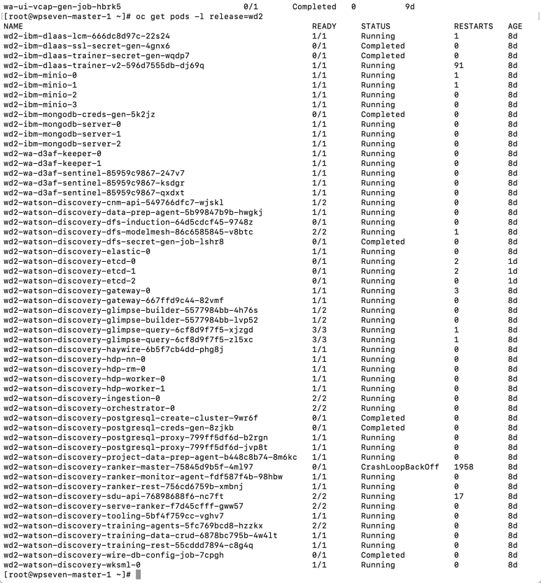
Assistant & Discovery Pods
WA
WD
Notes:
How do I know if my deployment was successful?
Jobs / pods / stateful sets first

